Slide 1
UMS with Kubernetes & Cassandra
1705031 - 1705034 - 1705041
ERD-UML PRESENTATION

Slide 2
Features
01
Master Admin
Student Info
02
Data Entry Admin
11
10
Finance
03
Library
09
Scholarship
04
Medical
Complain
05
Course Assignment
08
06
Exam
Result
07

Slide 3
Master Admin
Create Admin
Create Lower Admins
Department Head Assignment

Slide 4
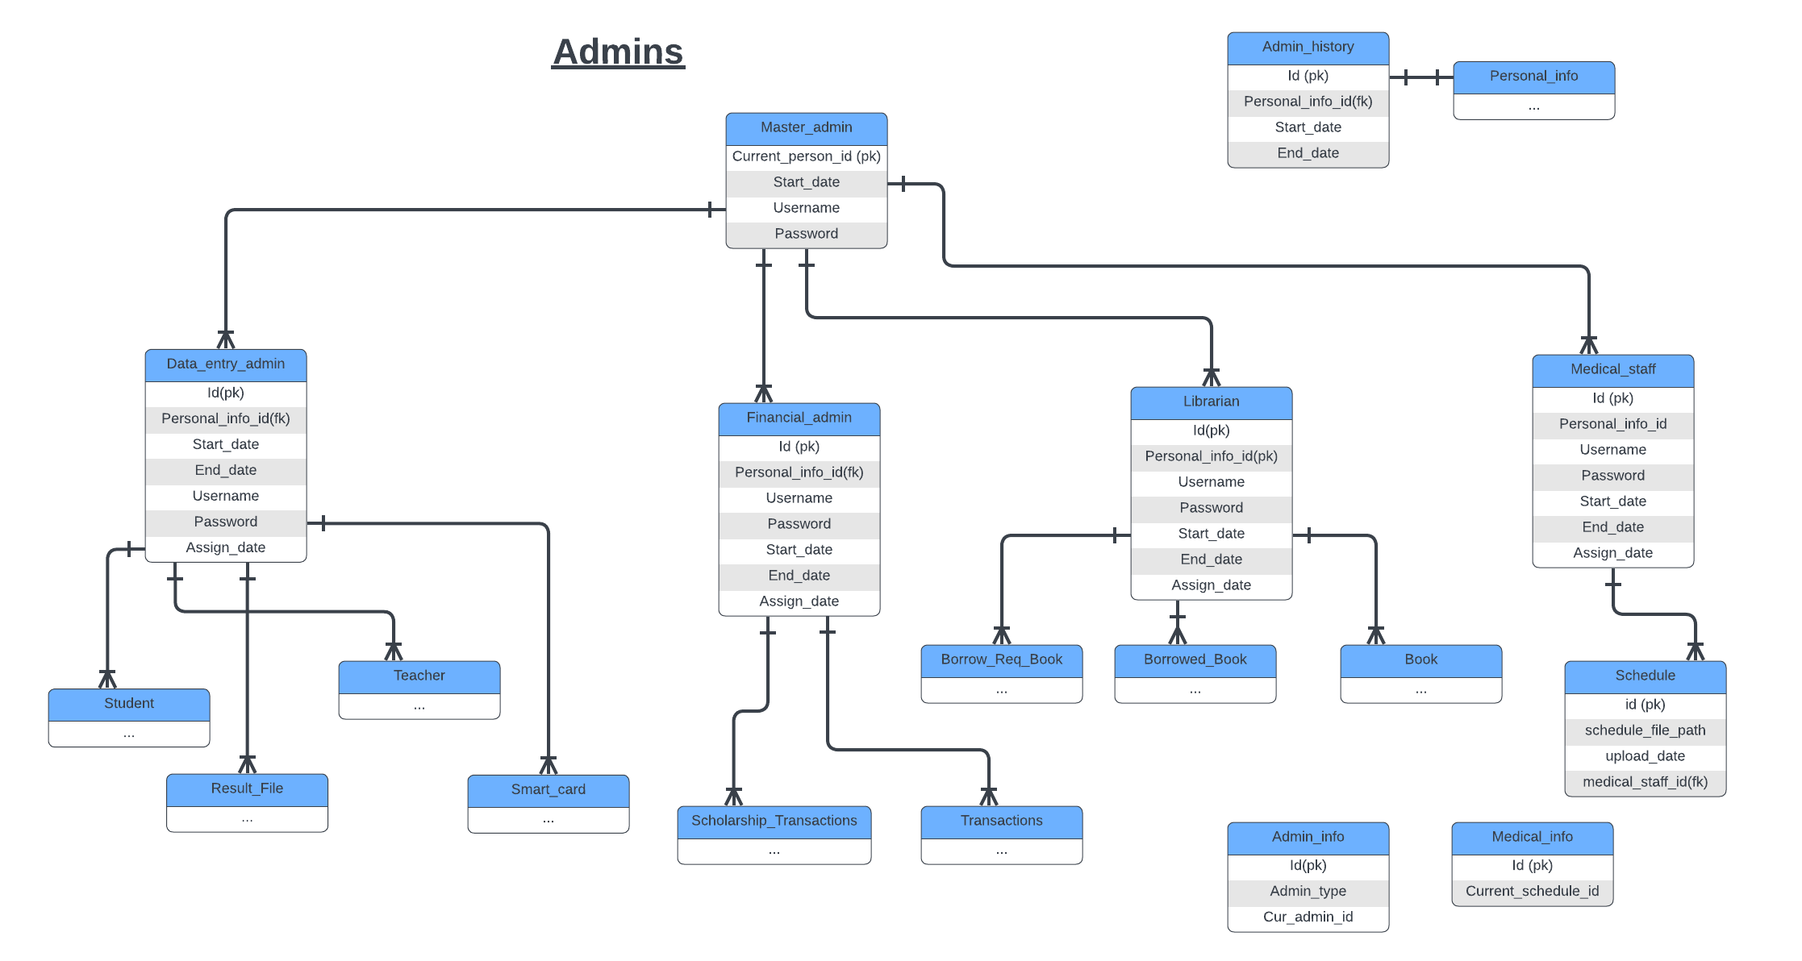

Slide 5
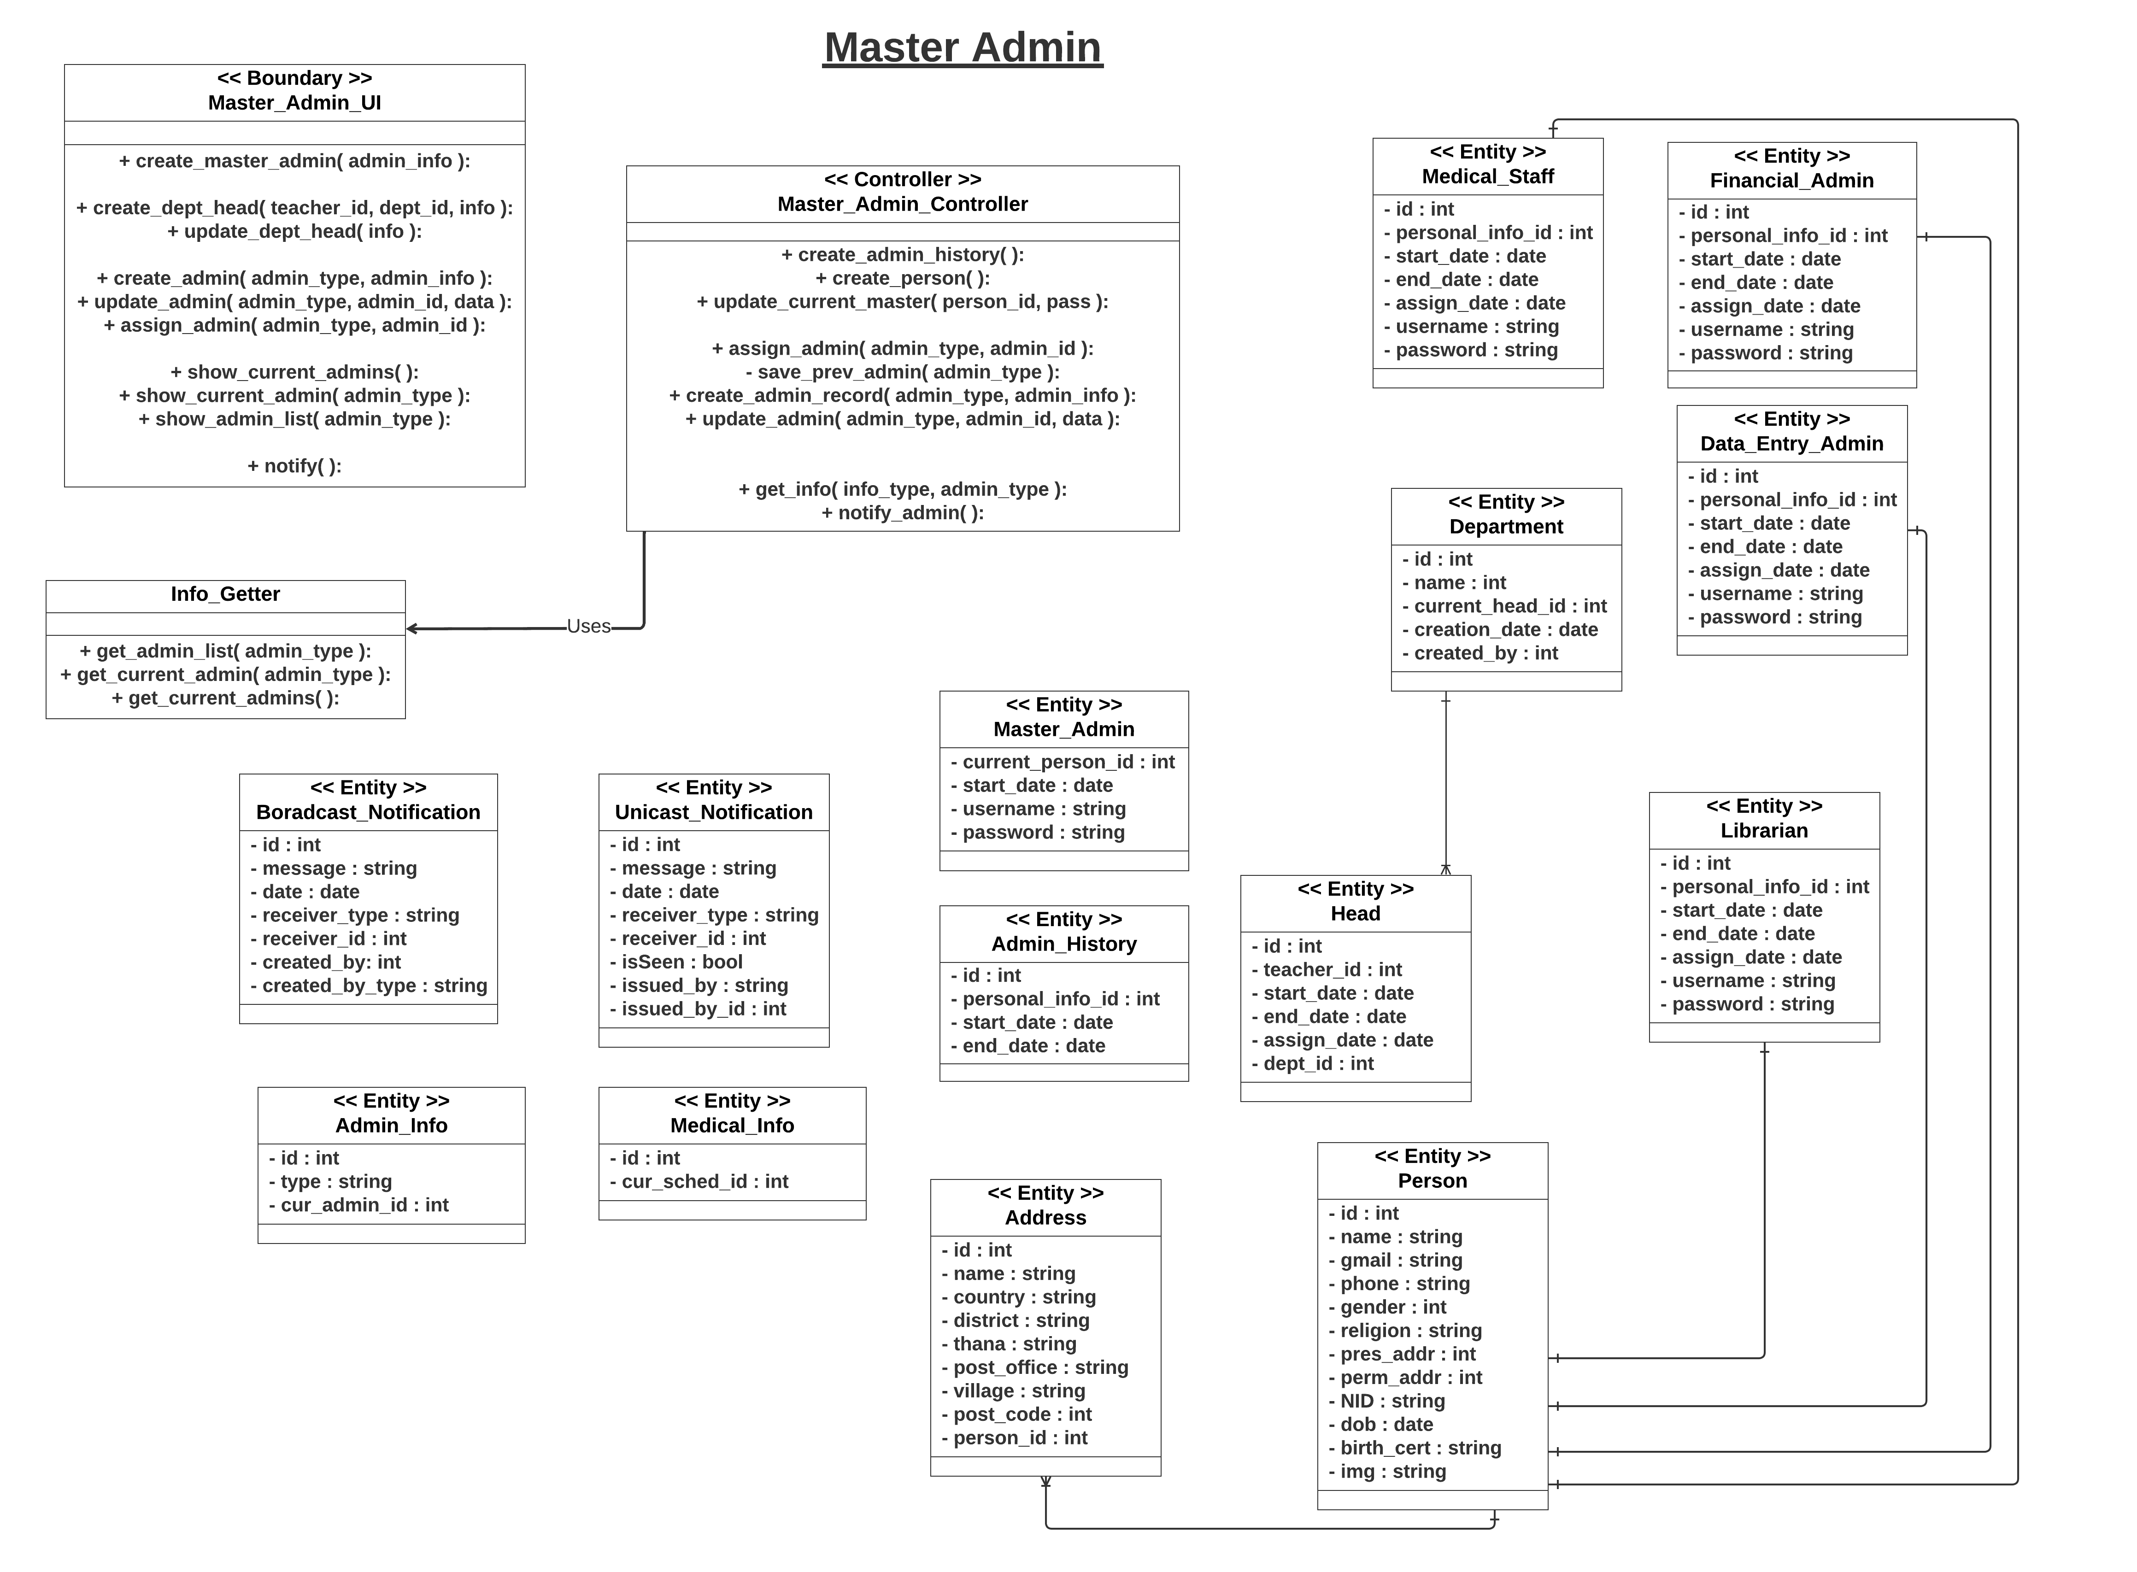

Slide 6
Features
01
Master Admin
Student Info
02
Data Entry Admin
11
10
Finance
03
Library
09
Scholarship
04
Medical
Complain
05
Course Assignment
08
06
Exam
Result
07

Slide 7
Data Entry Admin
Add New Students
Create Smart Cards
Add New Teachers
Assign Advisors
Notice
Session
Department
Room

Slide 8
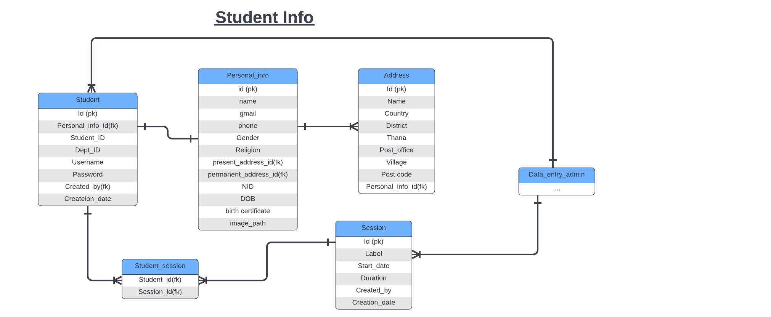

Slide 9
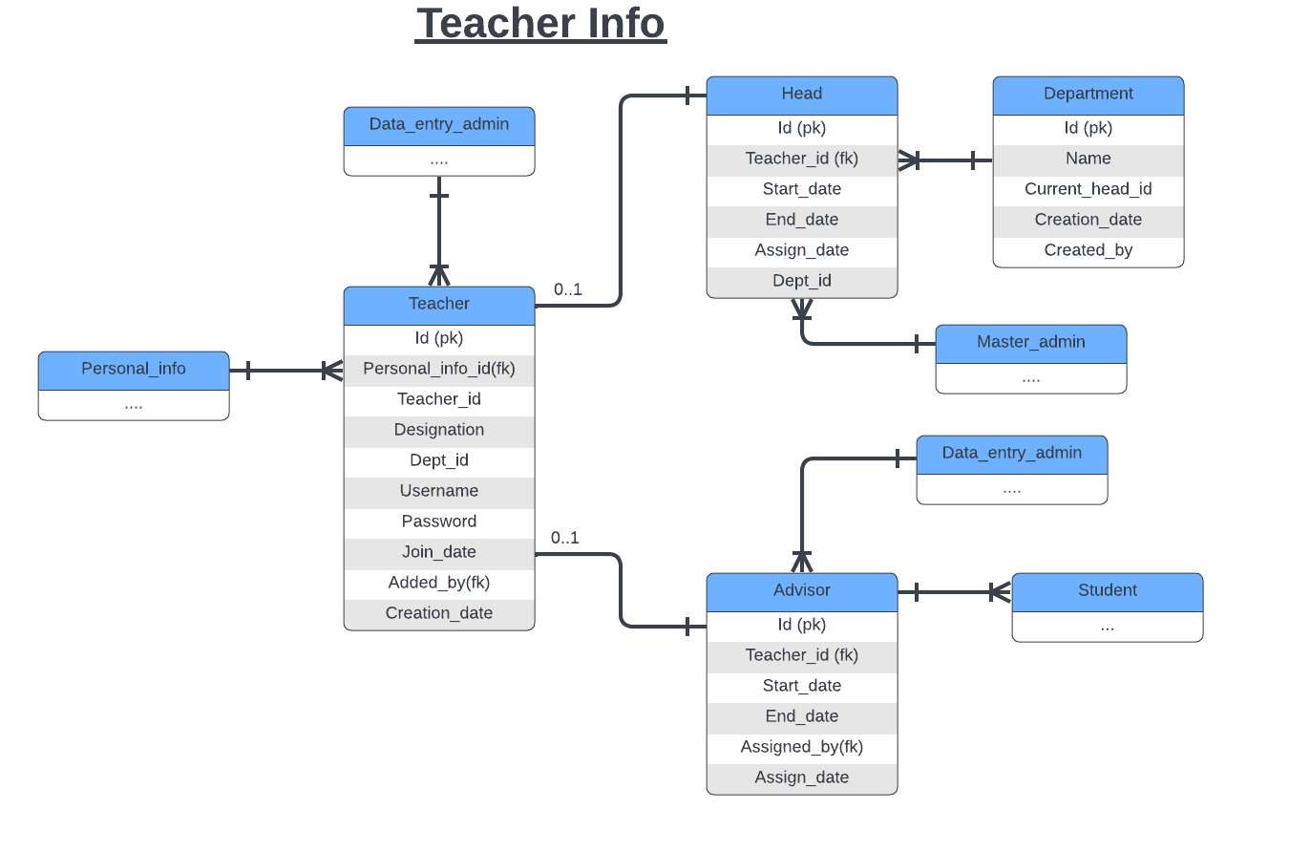

Slide 10
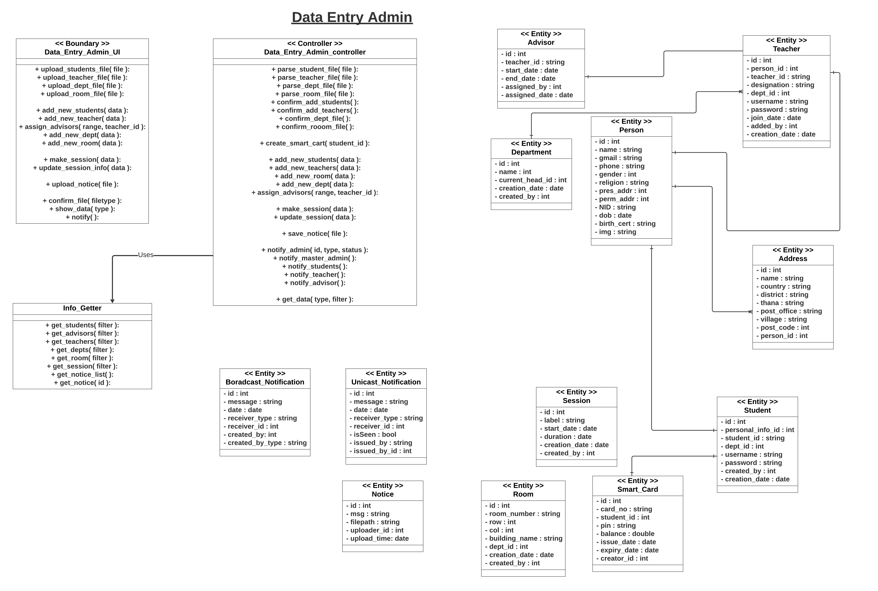

Slide 11
Features
01
Master Admin
Student Info
02
Data Entry Admin
11
10
Finance
03
Library
09
Scholarship
04
Medical
Complain
05
Course Assignment
08
06
Exam
Result
07

Slide 12
Library
Librarian
Add New Book
Approve/Decline Borrow Book Request
Approve/Decline New Book Request
Issue Fine
Term Final Ques
Student
Add New Book Request
Borrow Book Request

Slide 13
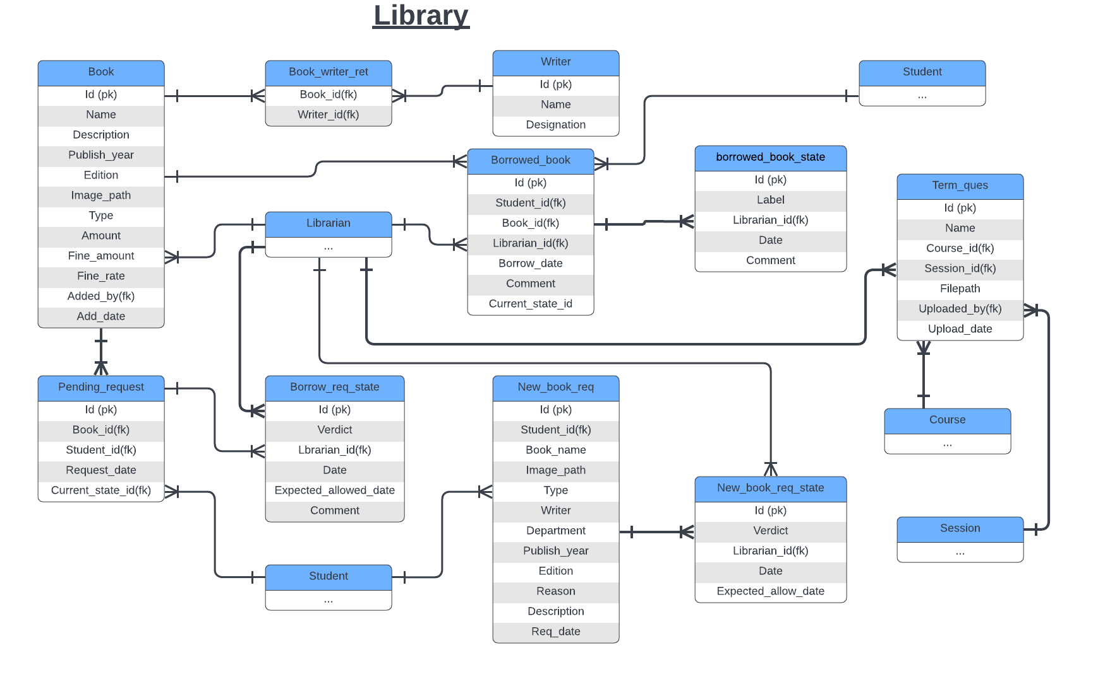

Slide 14
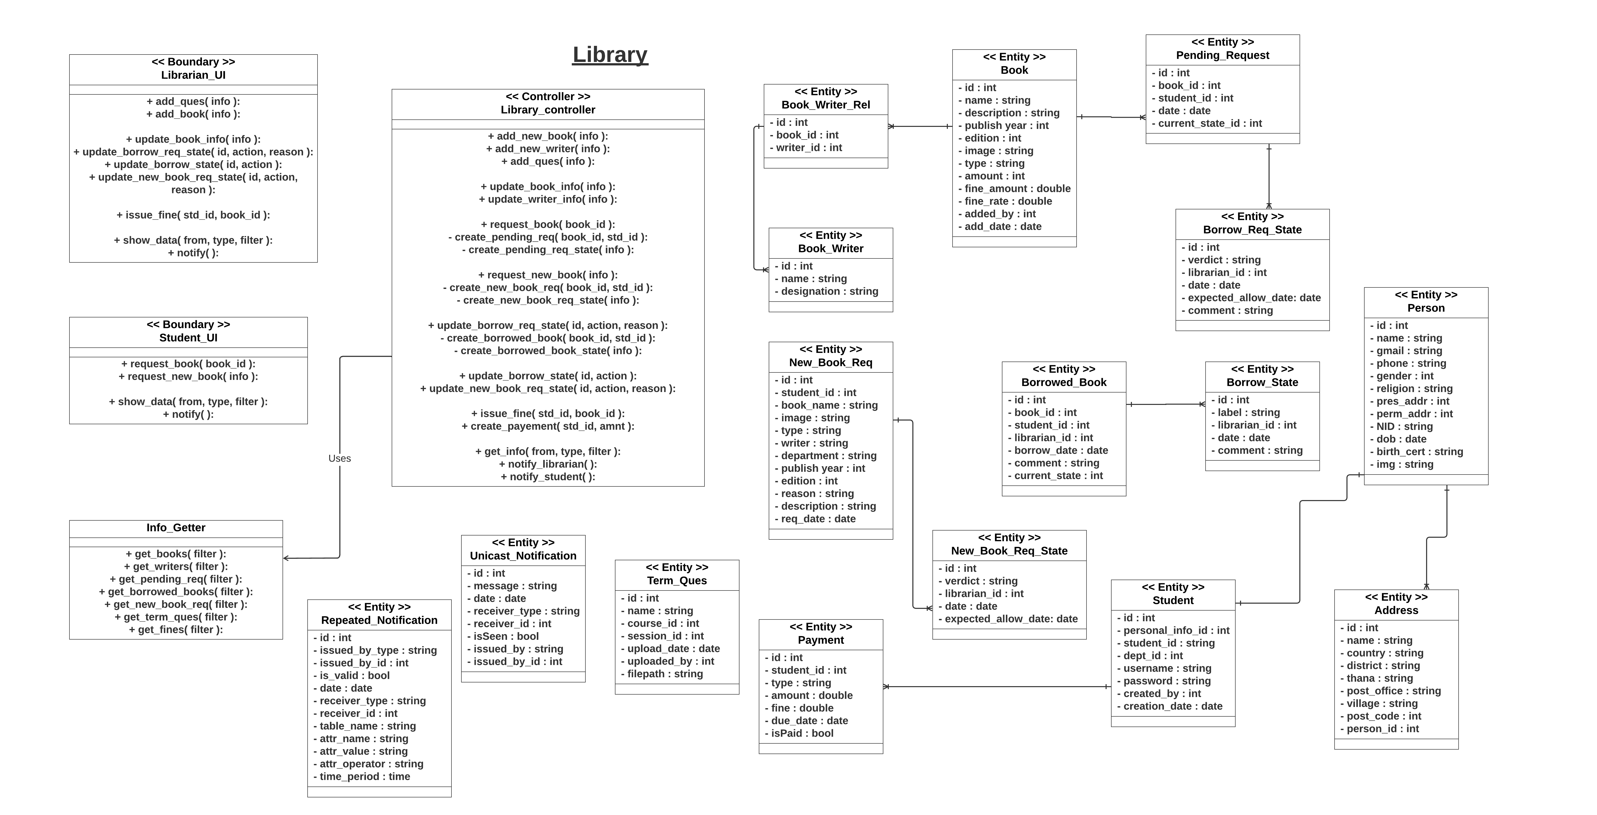

Slide 15
Features
01
Master Admin
Student Info
02
Data Entry Admin
11
10
Finance
03
Library
09
Scholarship
04
Medical
Complain
05
Course Assignment
08
06
Exam
Result
07

Slide 16
Medical
Staff
Add New Doctor
Update Doctor Info
Update Schedule
Approve/Decline Doctor Appointment
Student
Show Doctor Info
Show Schedule
Doctor Appointment Request

Slide 17
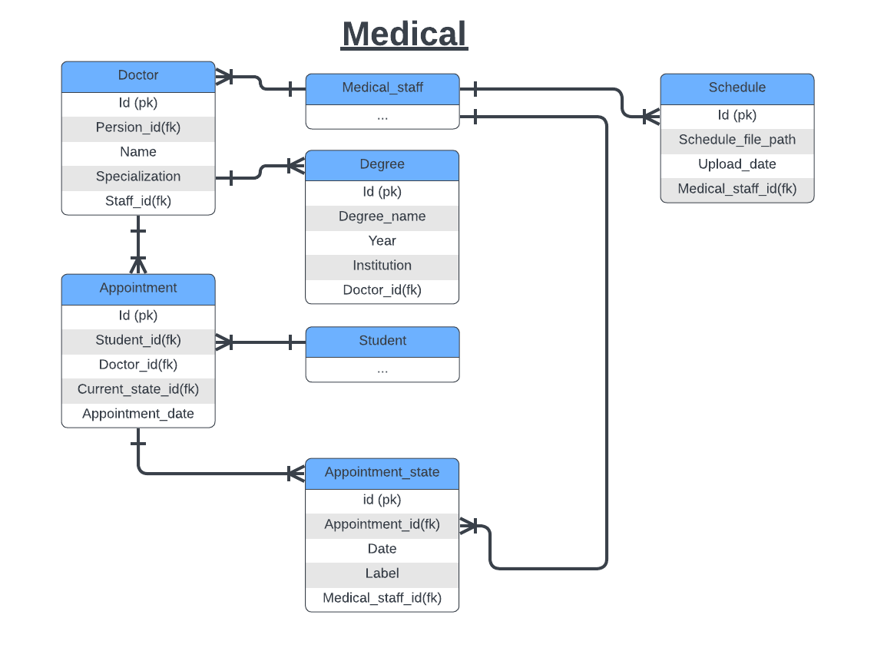

Slide 18
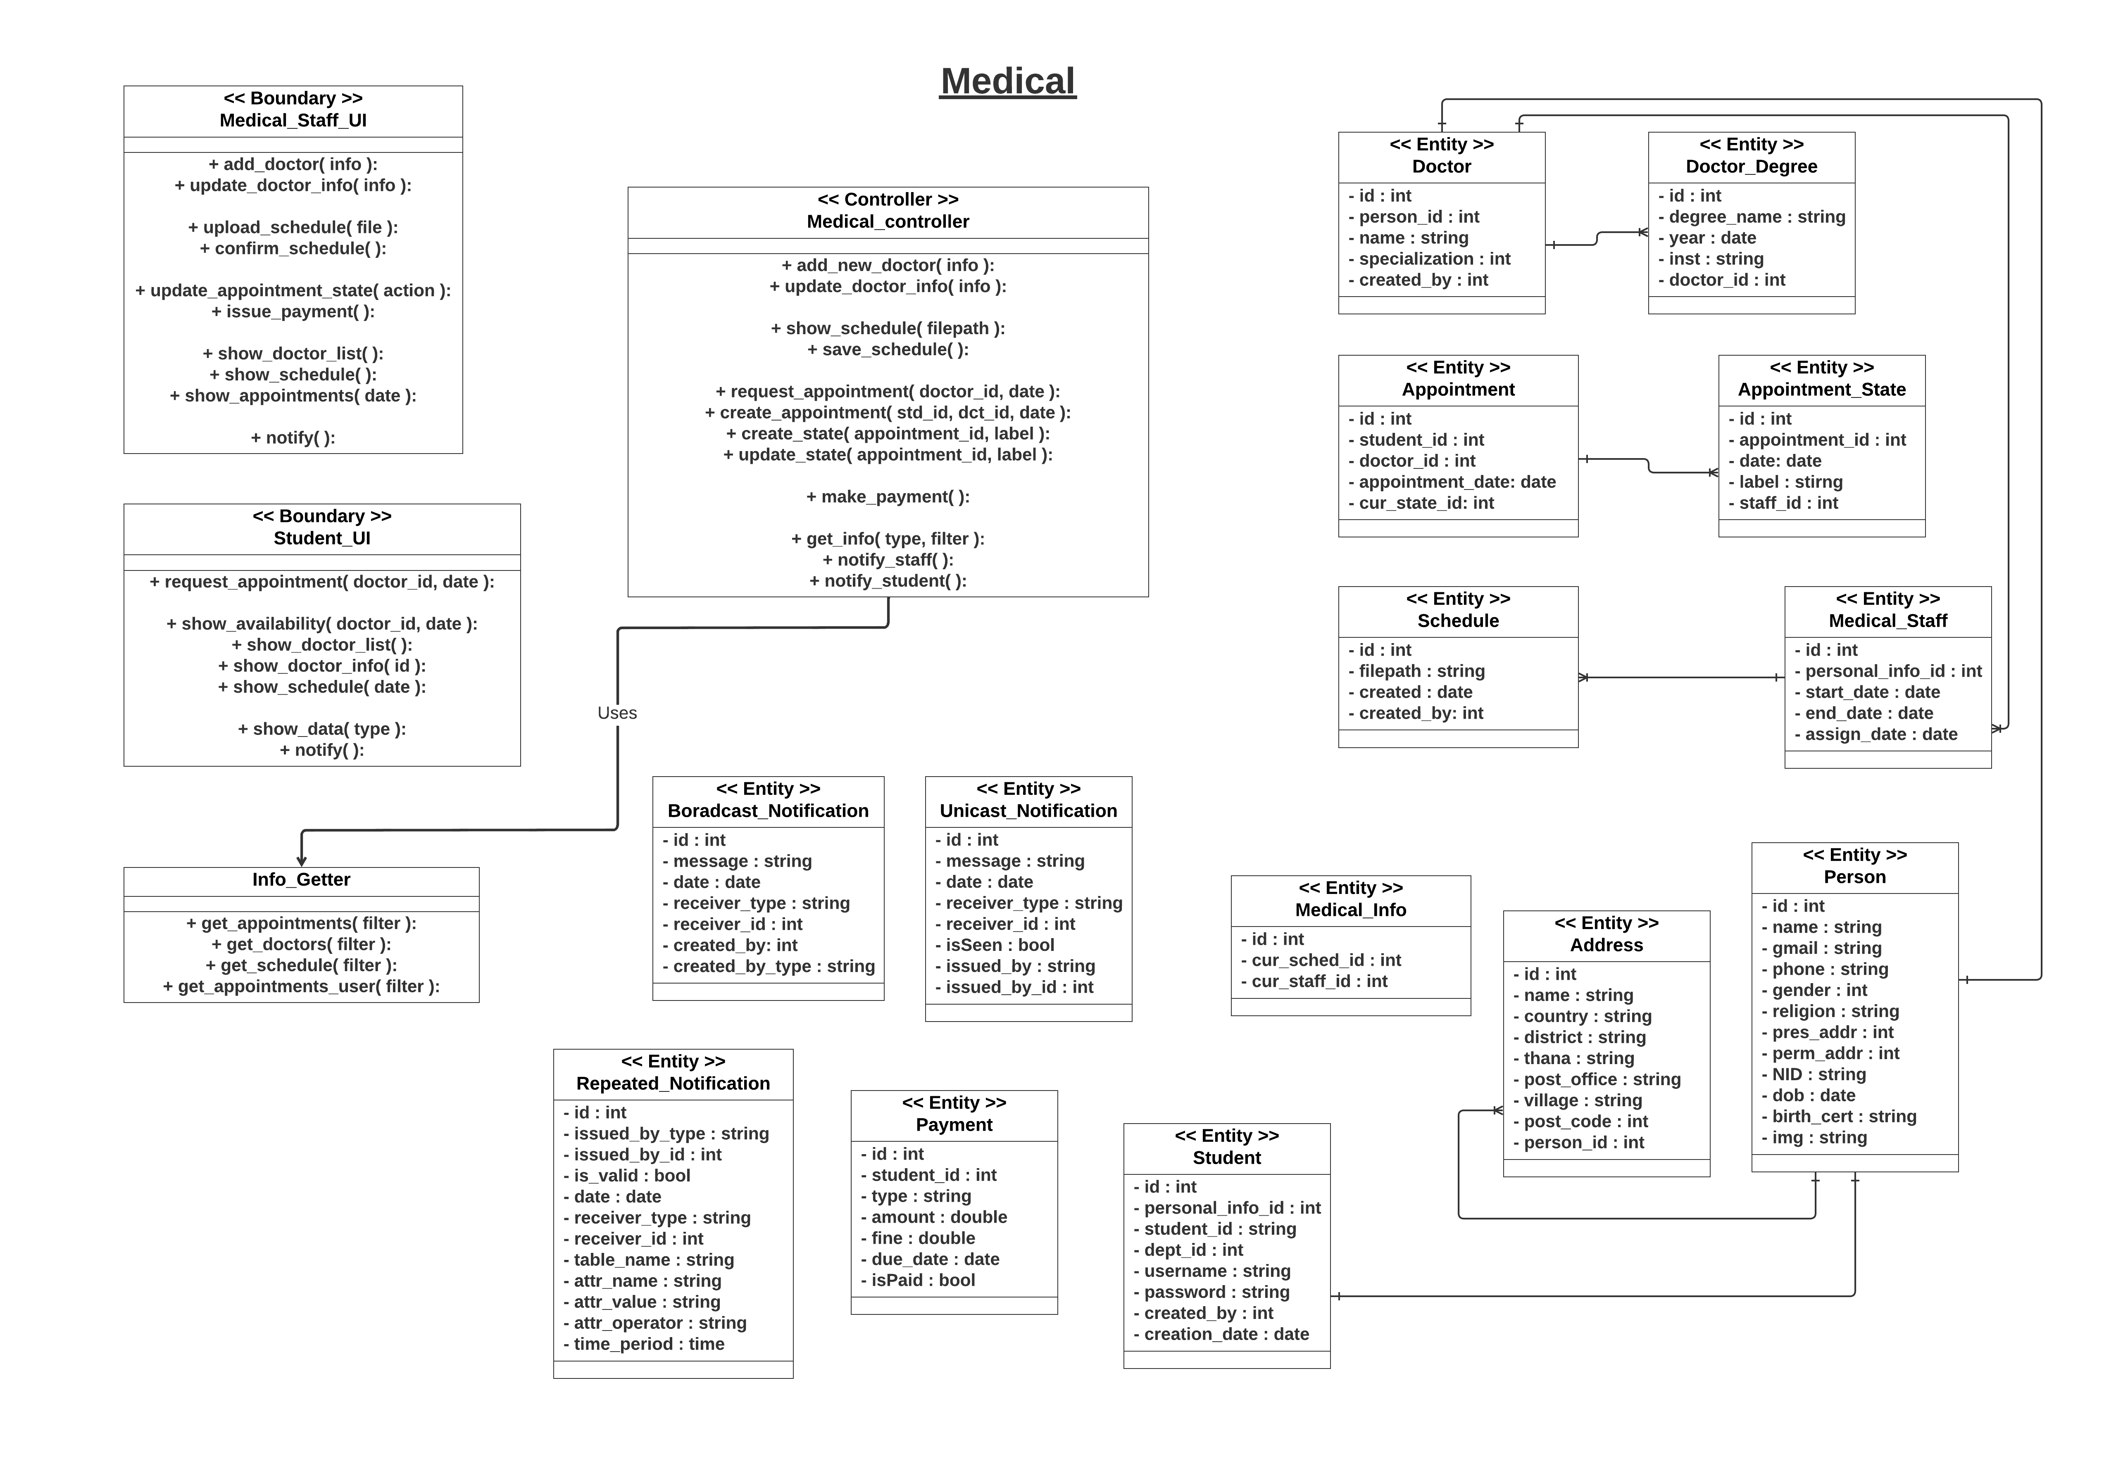

Slide 19
Features
01
Master Admin
Student Info
02
Data Entry Admin
11
10
Finance
03
Library
09
Scholarship
04
Medical
Complain
05
Course Assignment
08
06
Exam
Result
07

Slide 20
Course Assignment
Department Head
Create New Courses
Offer Courses
Data Entry Admin
Upload Routine
Advisor
Approve/Decline Course Request
Request Course
Verify Info Update
Student
Show Offered Courses
Request Course
Info Update

Slide 21
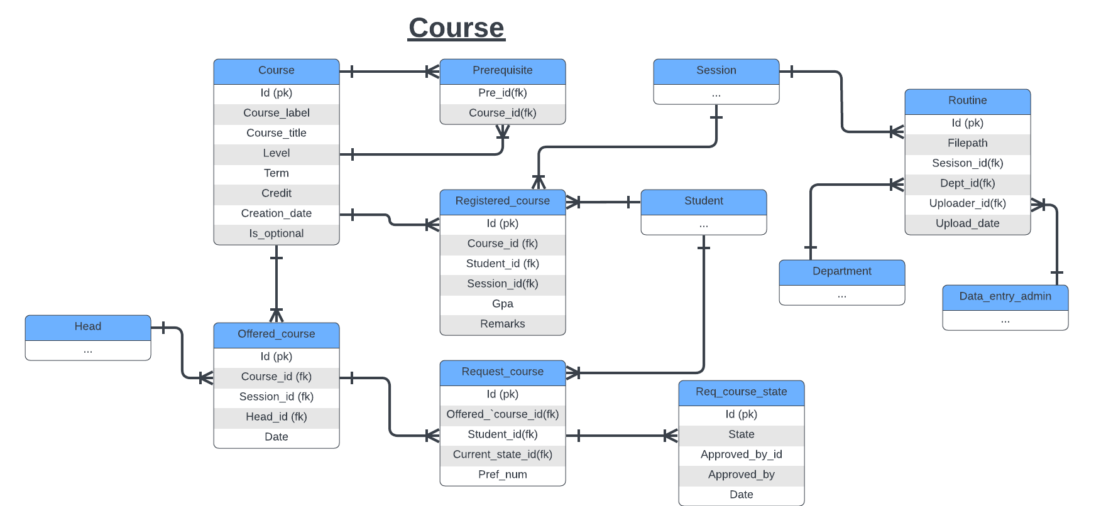

Slide 22
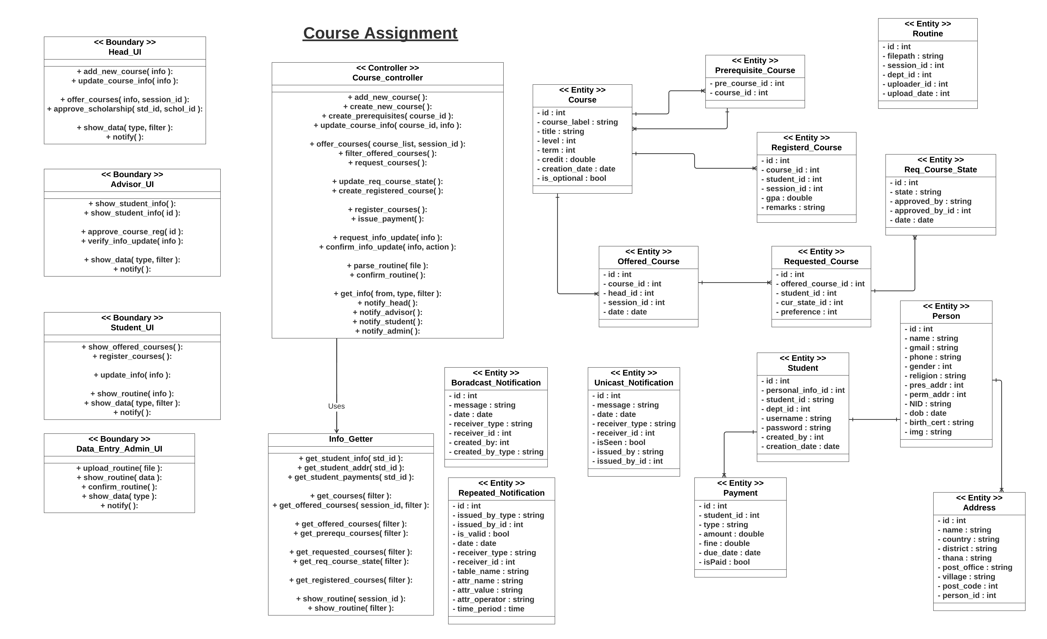

Slide 23
Features
01
Master Admin
Student Info
02
Data Entry Admin
11
10
Finance
03
Library
09
Scholarship
04
Medical
Complain
05
Course Assignment
08
06
Exam
Result
07

Slide 24
Exam
Data Entry Admin
Upload Exam Routine
Upload Seat Plan
Student
Show Exam Routines
Show Seat Plans

Slide 25
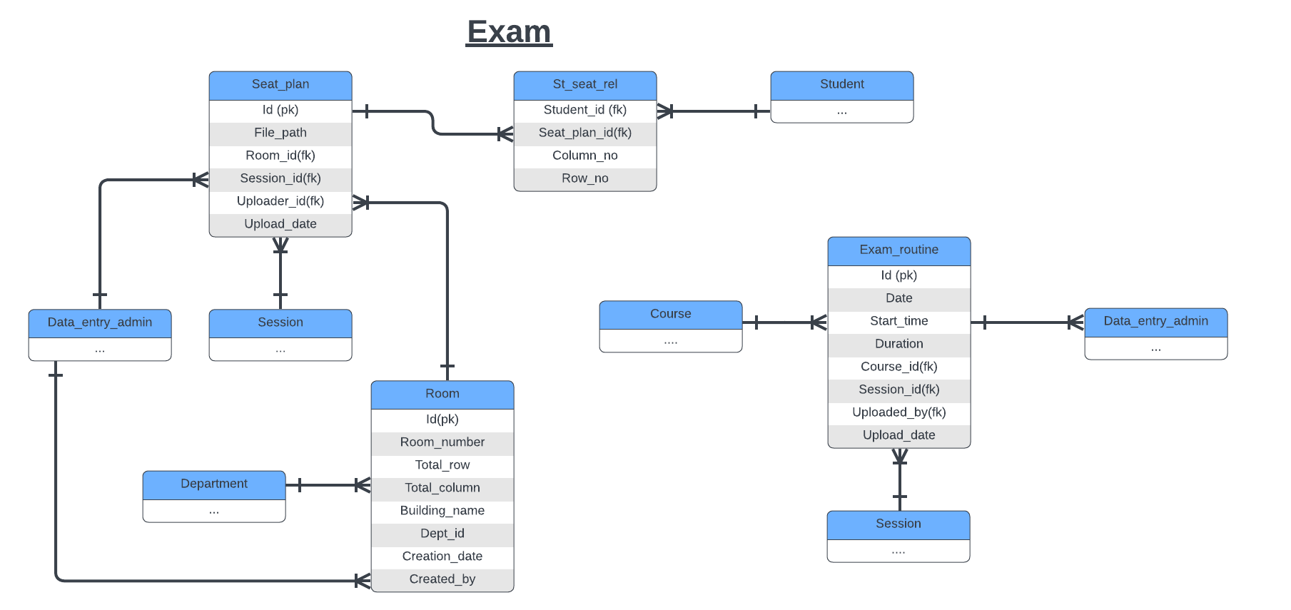

Slide 26
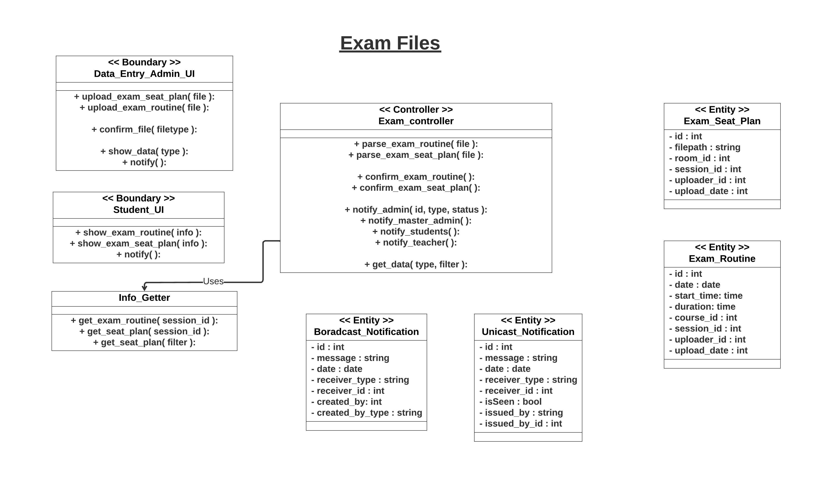

Slide 27
Features
01
Master Admin
Student Info
02
Data Entry Admin
11
10
Finance
03
Library
09
Scholarship
04
Medical
Complain
05
Course Assignment
08
06
Exam
Result
07

Slide 28
Result
Data Entry Admin
Upload Result of Courses
Master Admin
Ensure Upload of All Course Results
Publish Result Officially
Student
Show Own Result

Slide 29
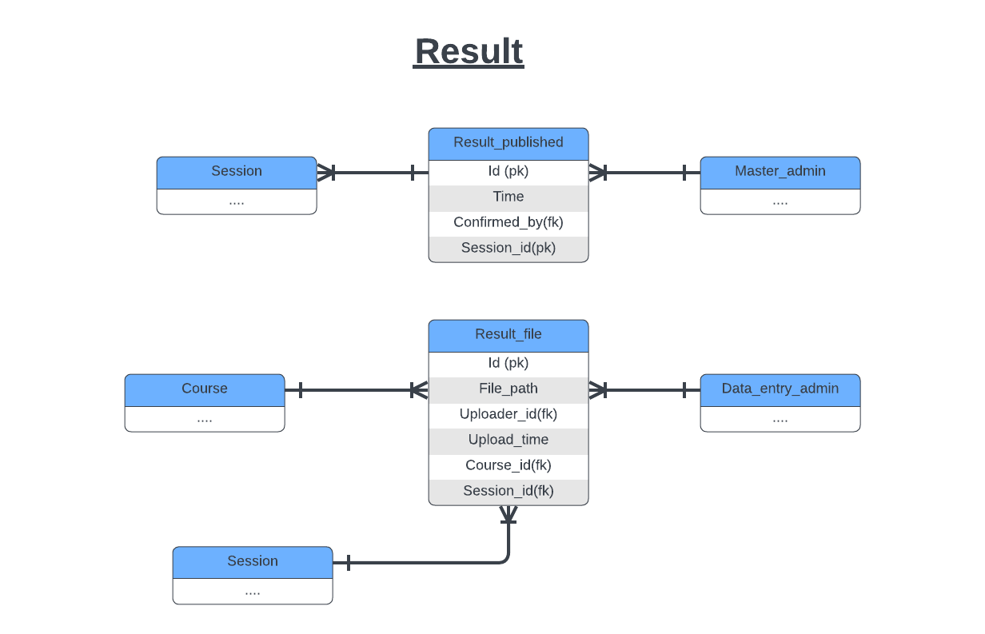

Slide 30
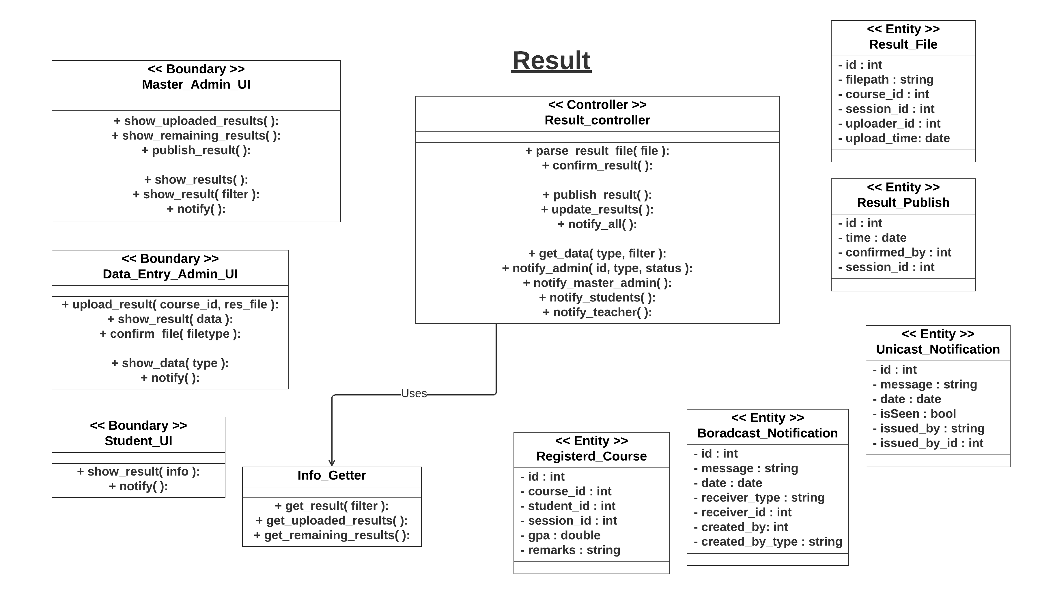

Slide 31
Features
01
Master Admin
Student Info
02
Data Entry Admin
11
10
Finance
03
Library
09
Scholarship
04
Medical
Complain
05
Course Assignment
08
06
Exam
Result
07

Slide 32
Complain
Department Head
Show Complains
Handle A Complain
Show Student Info
Show Student History
Student
Issue Complain
Show Complain State
Show Previous Complains

Slide 33
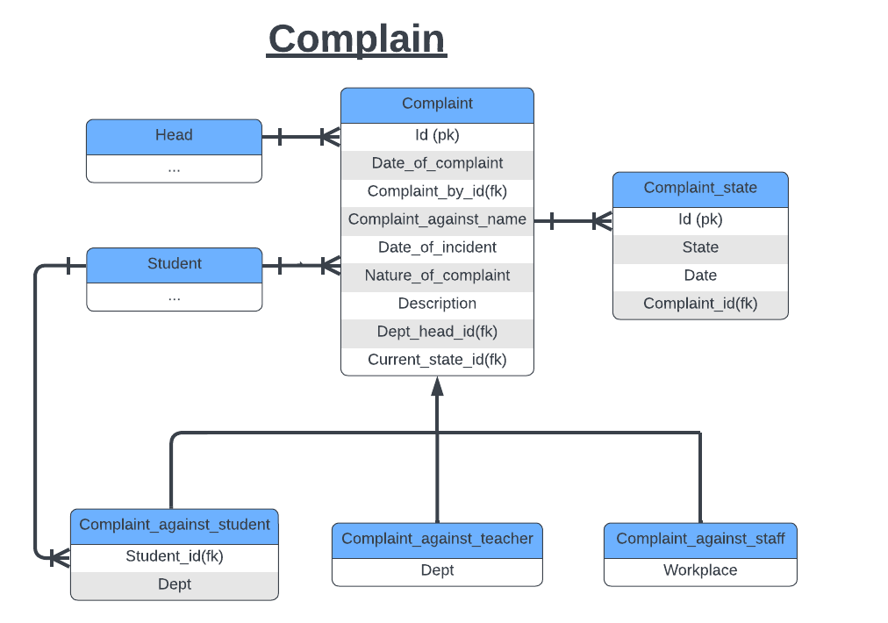

Slide 34
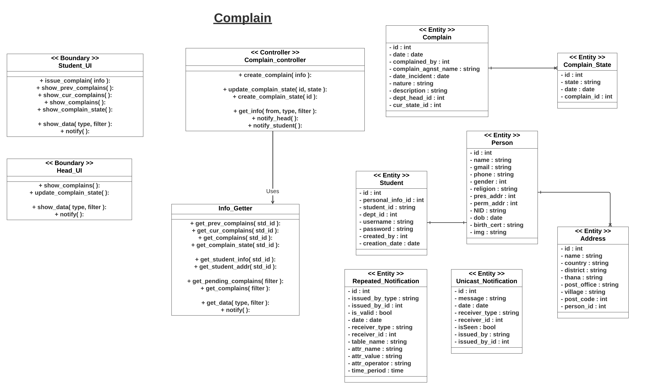

Slide 35
Features
01
Master Admin
Student Info
02
Data Entry Admin
11
10
Finance
03
Library
09
Scholarship
04
Medical
Complain
05
Course Assignment
08
06
Exam
Result
07

Slide 36
Scholarship
Data Entry Admin
Create New Scholarships
Upload Scholarship Eligibility Info
Show Student Info
Show Student History
Department Head
Approve/Decline A Scholarship
Request
Student
Apply For A Scholarship
Hall System
Approve/Decline A Scholarship Request
Advisor
Check Eligibility of A Request
Approve/Decline A Scholarship Request

Slide 37
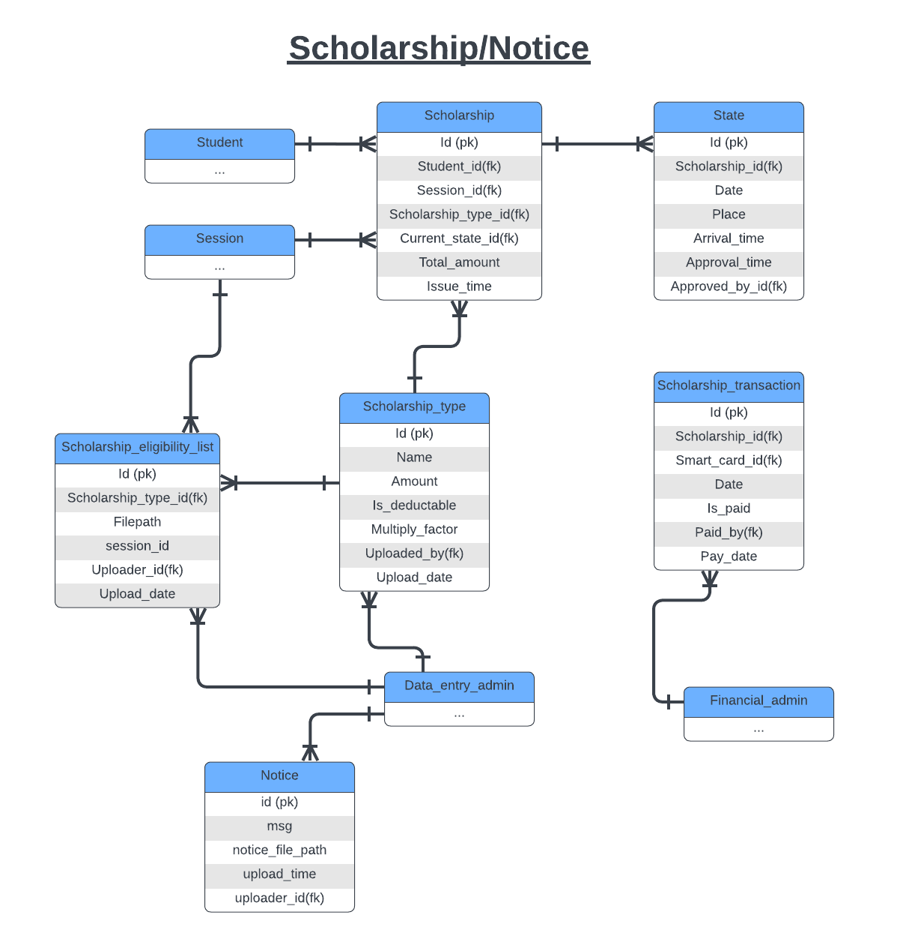

Slide 38
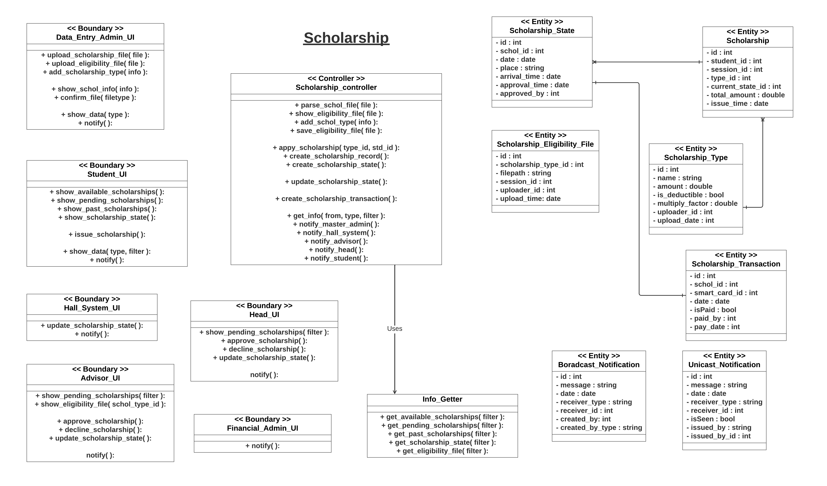

Slide 39
Features
01
Master Admin
Student Info
02
Data Entry Admin
11
10
Finance
03
Library
09
Scholarship
04
Medical
Complain
05
Course Assignment
08
06
Exam
Result
07

Slide 40
Finance
Fincancial Admin
Update Smart Card Info
Cash In
Cash Out
Pay Scholarship Transactions
Bank
Confirm a Payment
Hall System
Issue Hall Fee
Student
Pay Dues
Show Card Info

Slide 41
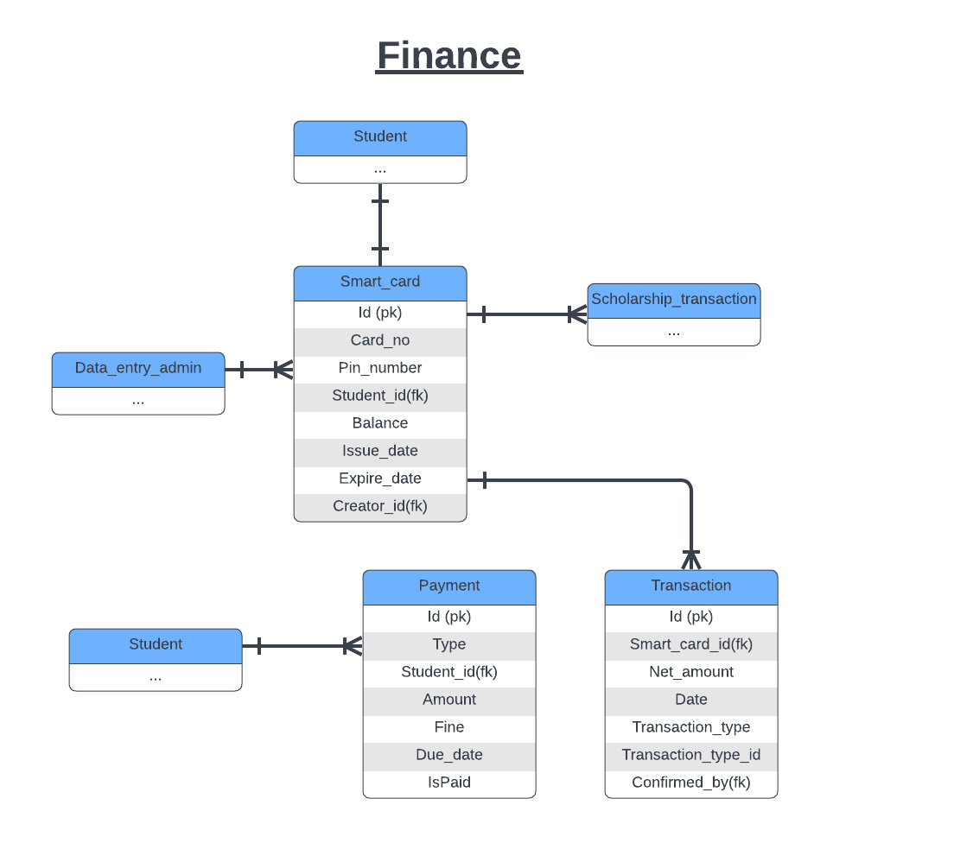

Slide 42
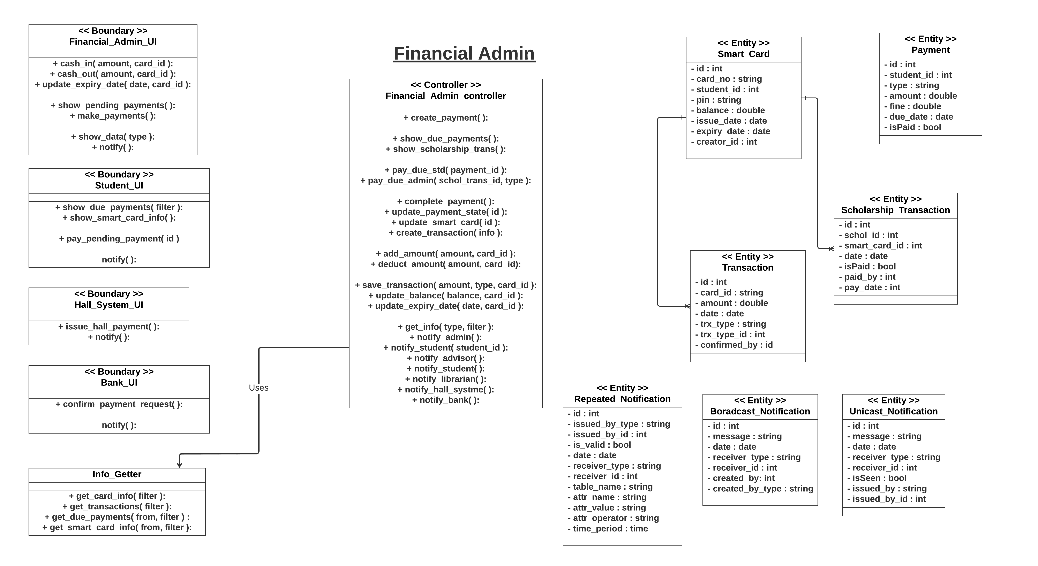

Slide 43
Features
01
Master Admin
Student Info
02
Data Entry Admin
11
10
Finance
03
Library
09
Scholarship
04
Medical
Complain
05
Course Assignment
08
06
Exam
Result
07

Slide 44
Student Info
Student
Show Student Info
Show Teachers’ Info
Show Department Info
…..
…..

Slide 46
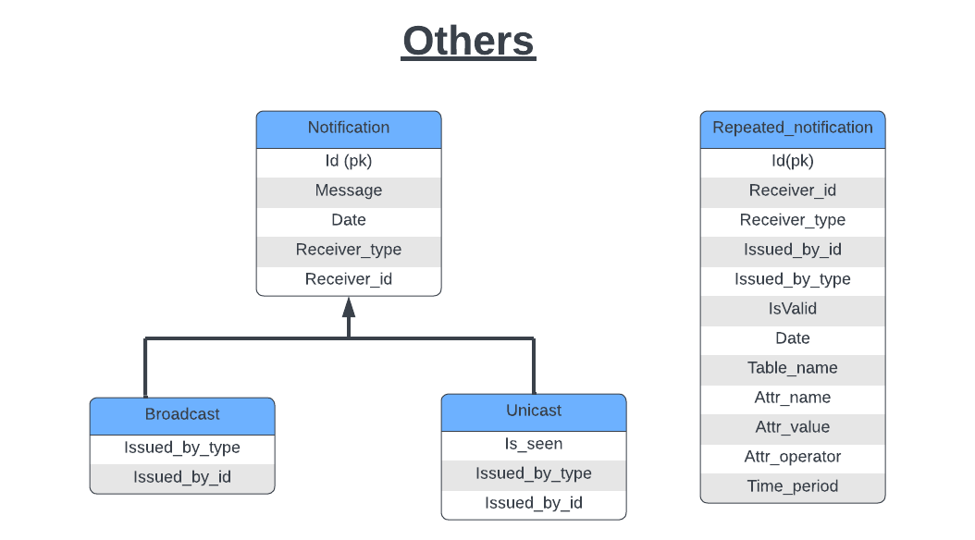
Notification

Slide 47
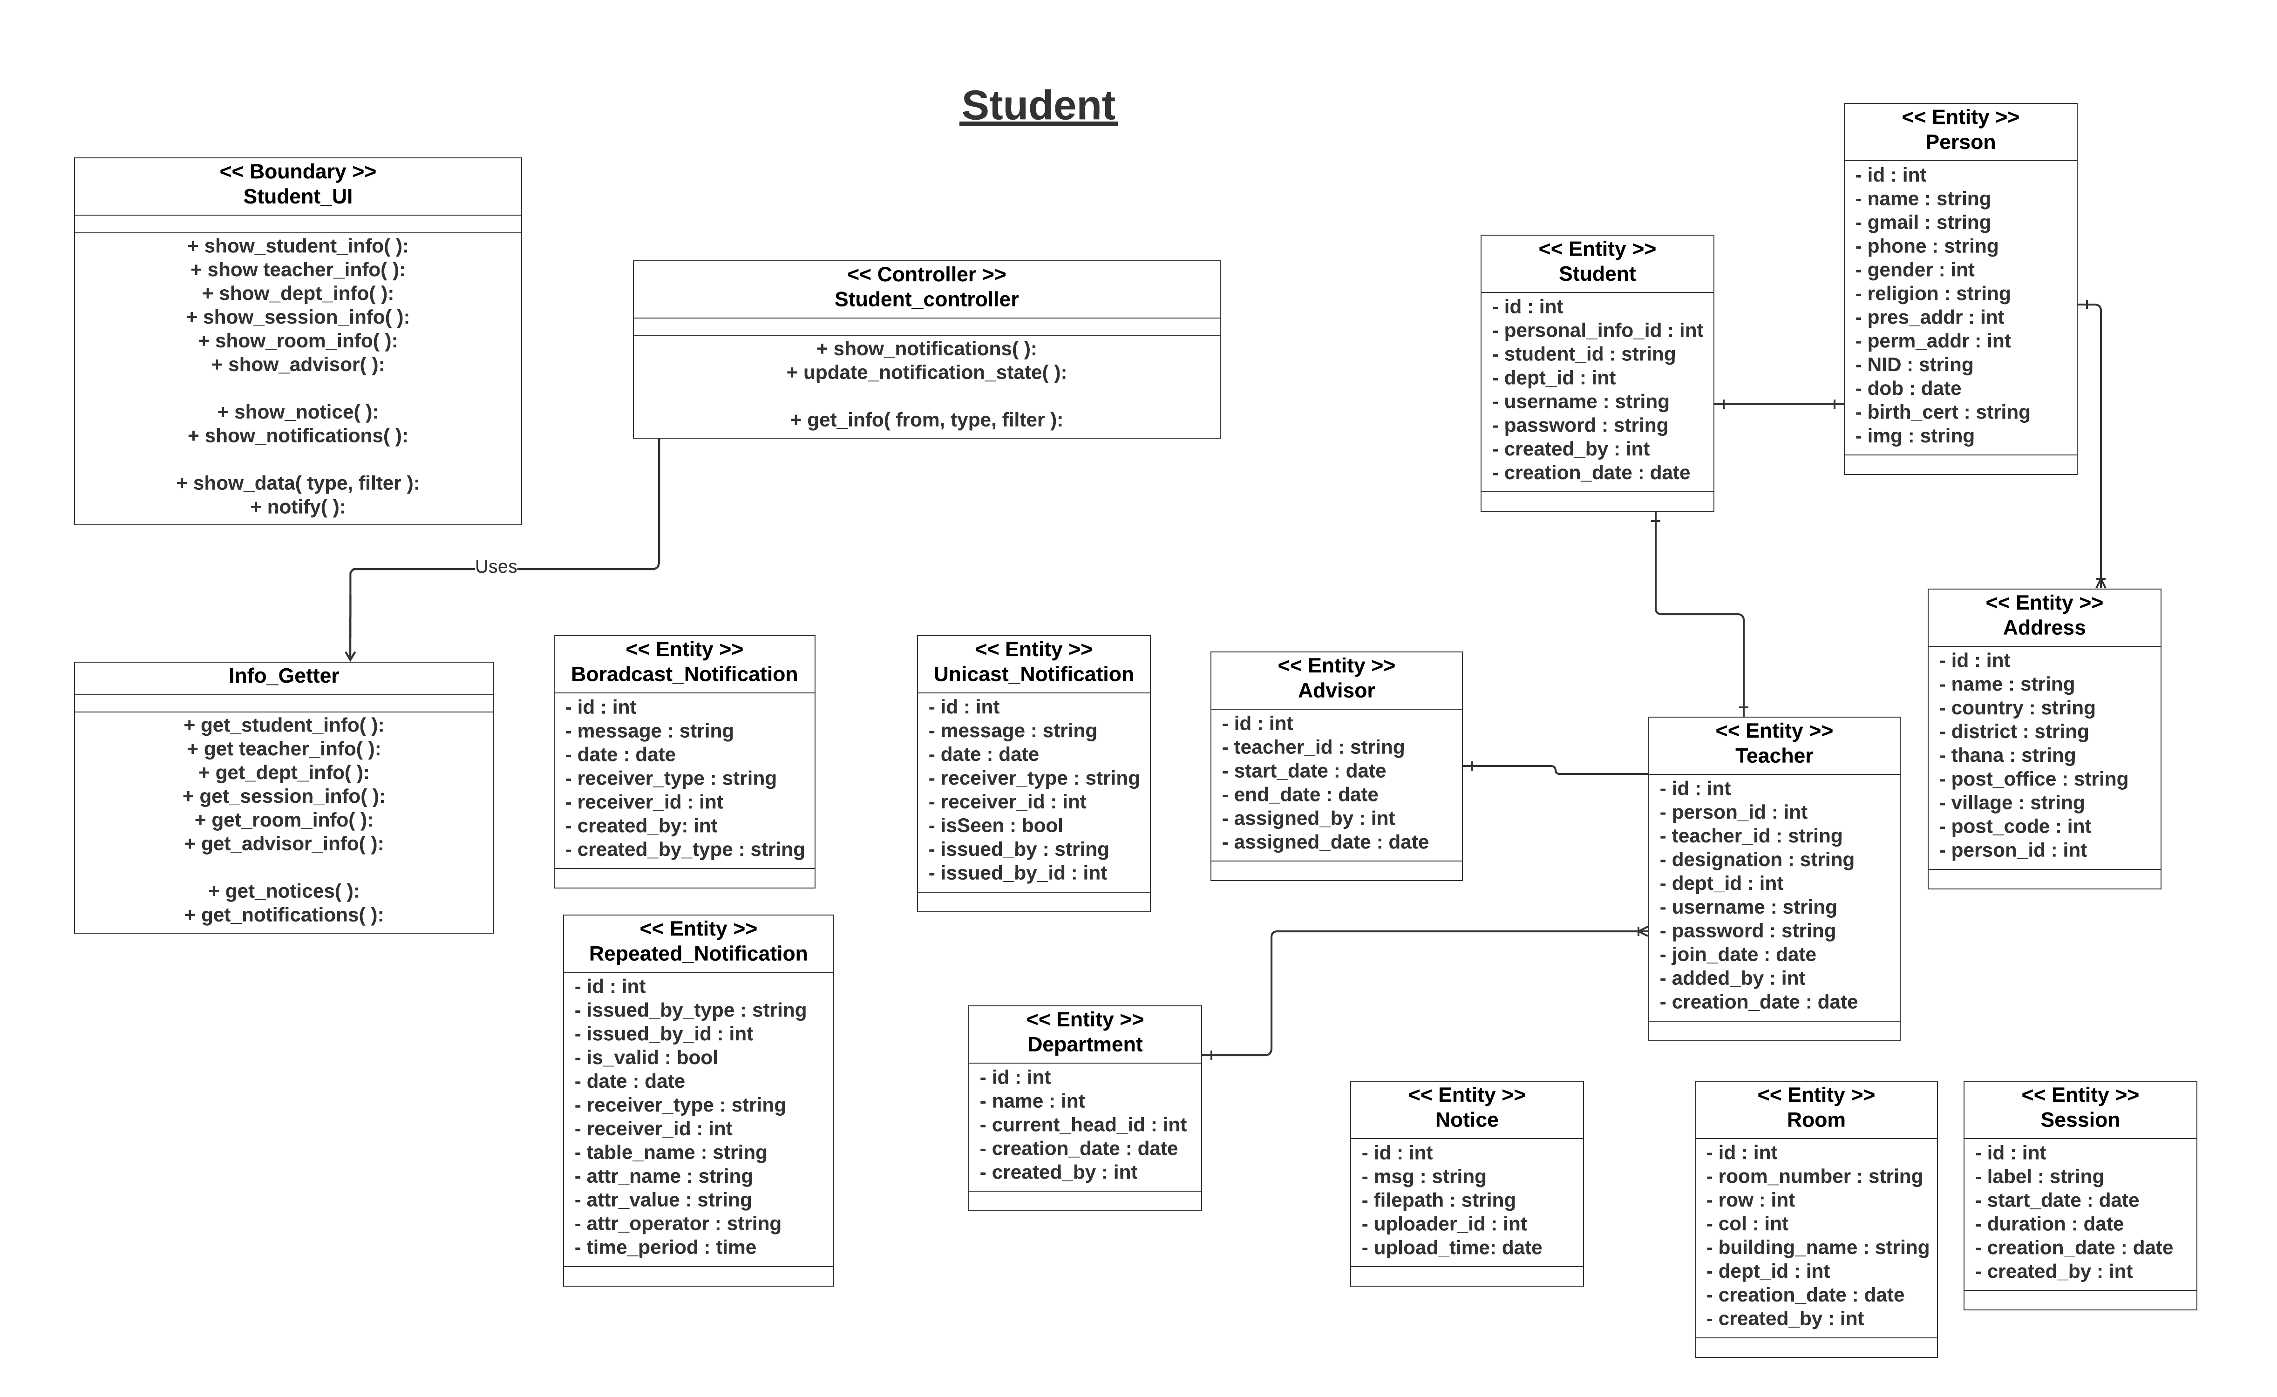

Slide 48
THANK YOU

